Slide 1
Applied Statistical Analysis
EDUC 6050
Week 1
Finding clarity using data

Slide 2
Welcome
What is quantitative research?
How does data inform our world?
How are data analyzed?

Slide 3
Data, Data, Data, Data, Data, ...
Tesla Autopilot

Slide 4
Data, Data, Data, Data, Data, ...
Notes:
When we know how to work with data, we can get clear conclusions even from loads of data.

Slide 5
Data, Data, Data, Data, Data, ...
Health Care Policy and Cost

Slide 6
Data are/is Cool
“In God we trust. All others must bring data.”
W. Edwards Deming
“It is a capital mistake to theorize before one has data.”
Sherlock Holmes, “A Study in Scarlett” (Arthur Conan Doyle).
“You can have data without information, but you cannot have information without data.”
Daniel Keys Moran

Slide 7
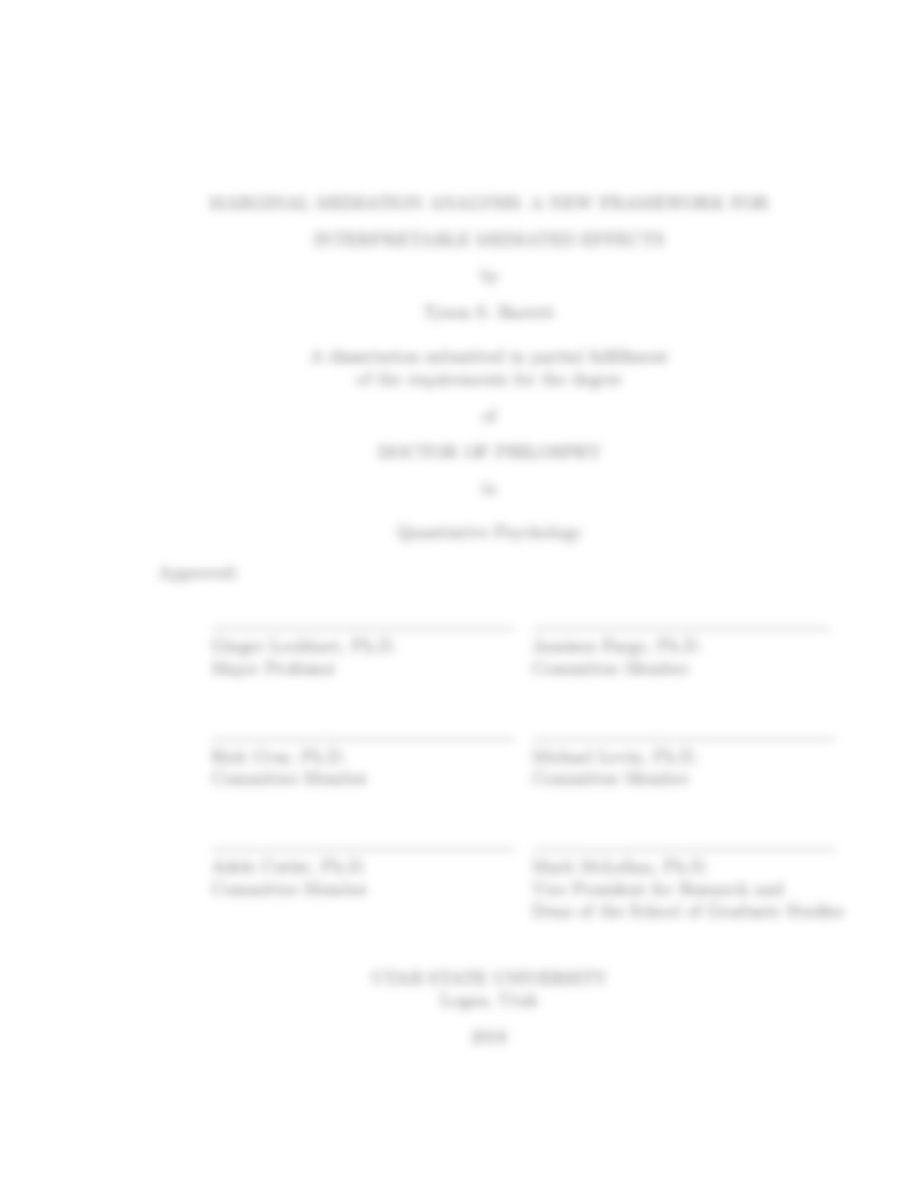

Purpose of this course
Develop quantitative understanding and skills
Prepare you for:
Your thesis
Your career
Notes:
Thesis: perform you own analyses and interpret them
Career: communicate with, work with, and understand statisticians and data scientists that you will be working with (they are everywhere…)

Slide 8
What is expected of you
Attend and participate in class
Prepare for class (readings before class)
Professional correspondence with colleagues
Use assignments to learn
Ask questions
Communicate with me

Slide 9
Syllabus
https://tysonbarrett.com/syllabus/asa

Slide 10
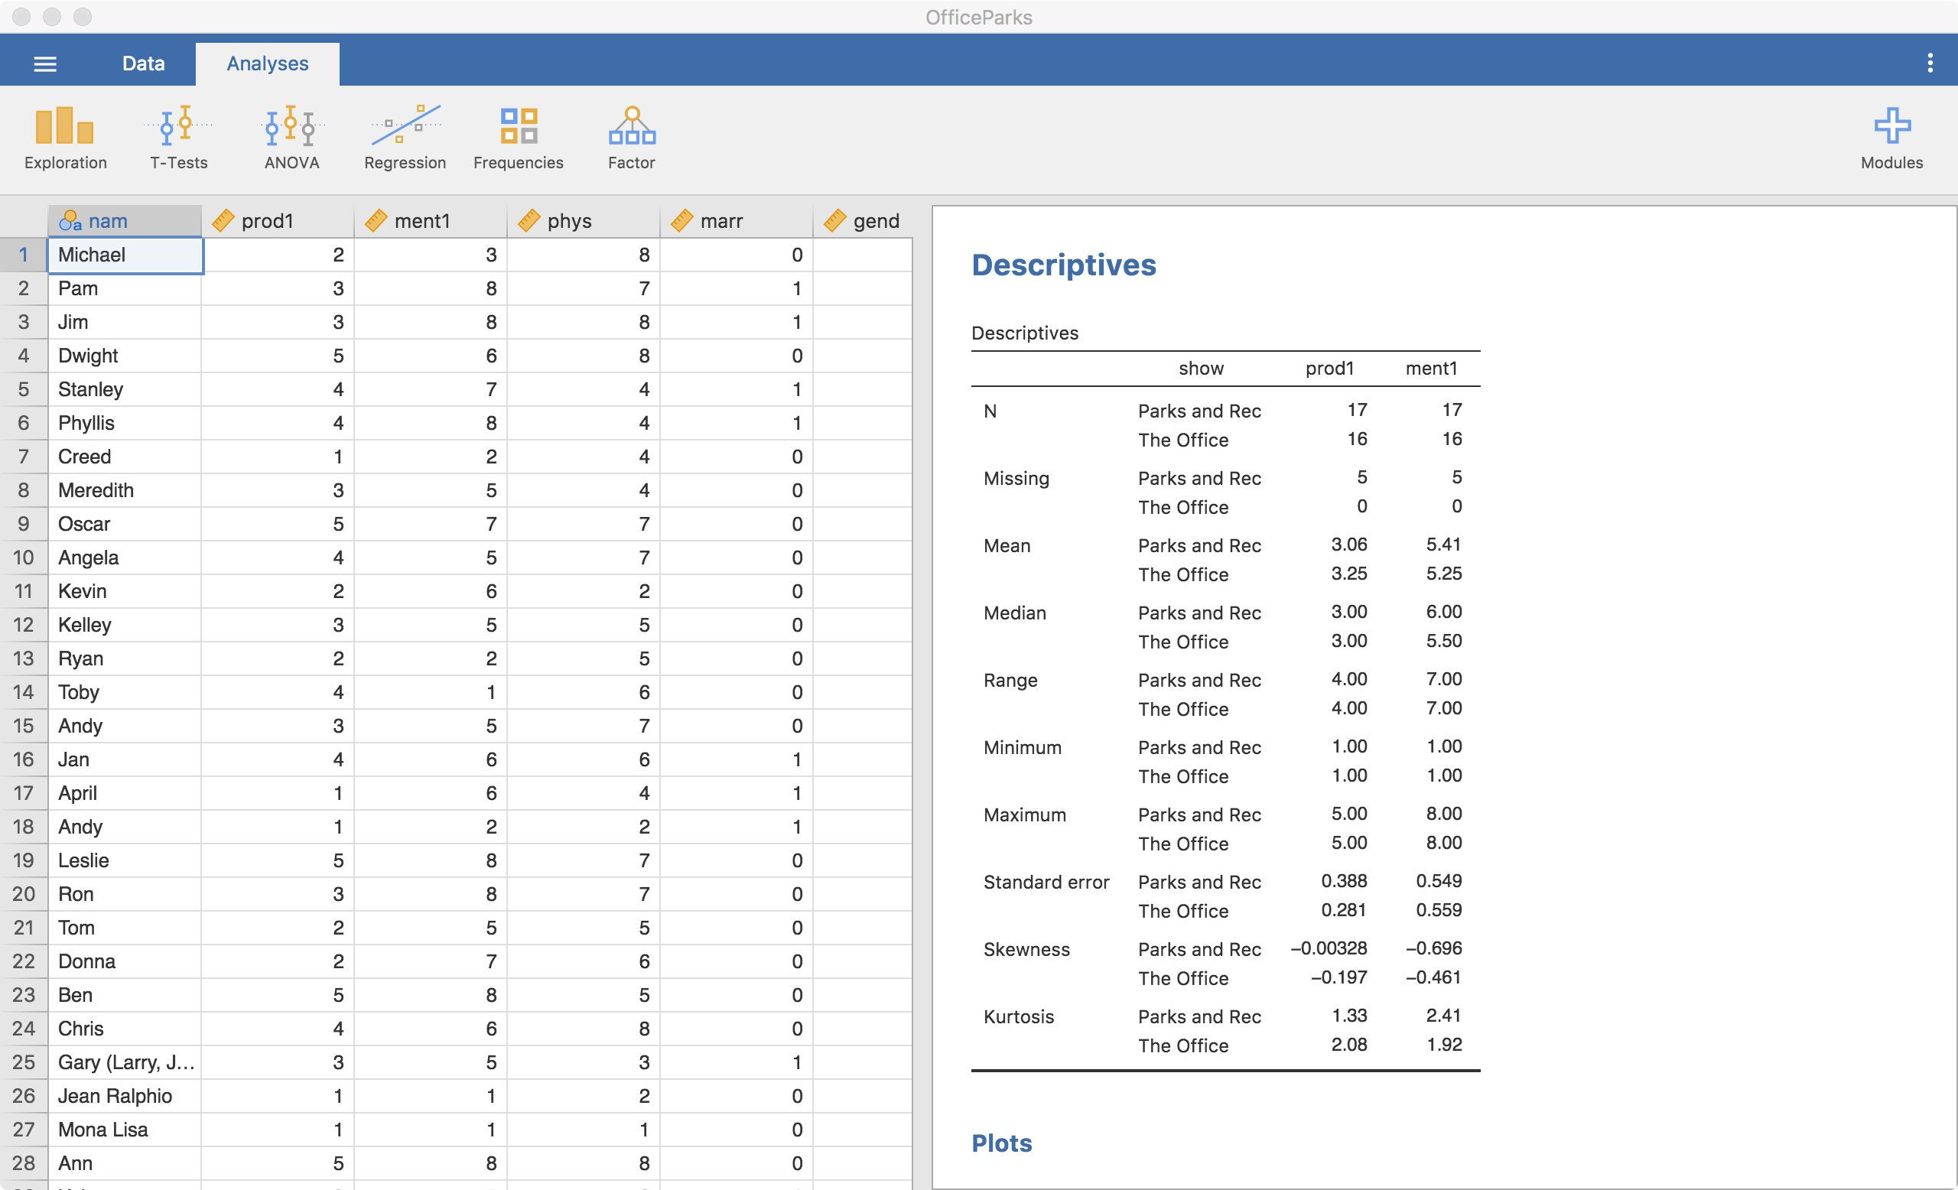
Jamovi

Slide 11
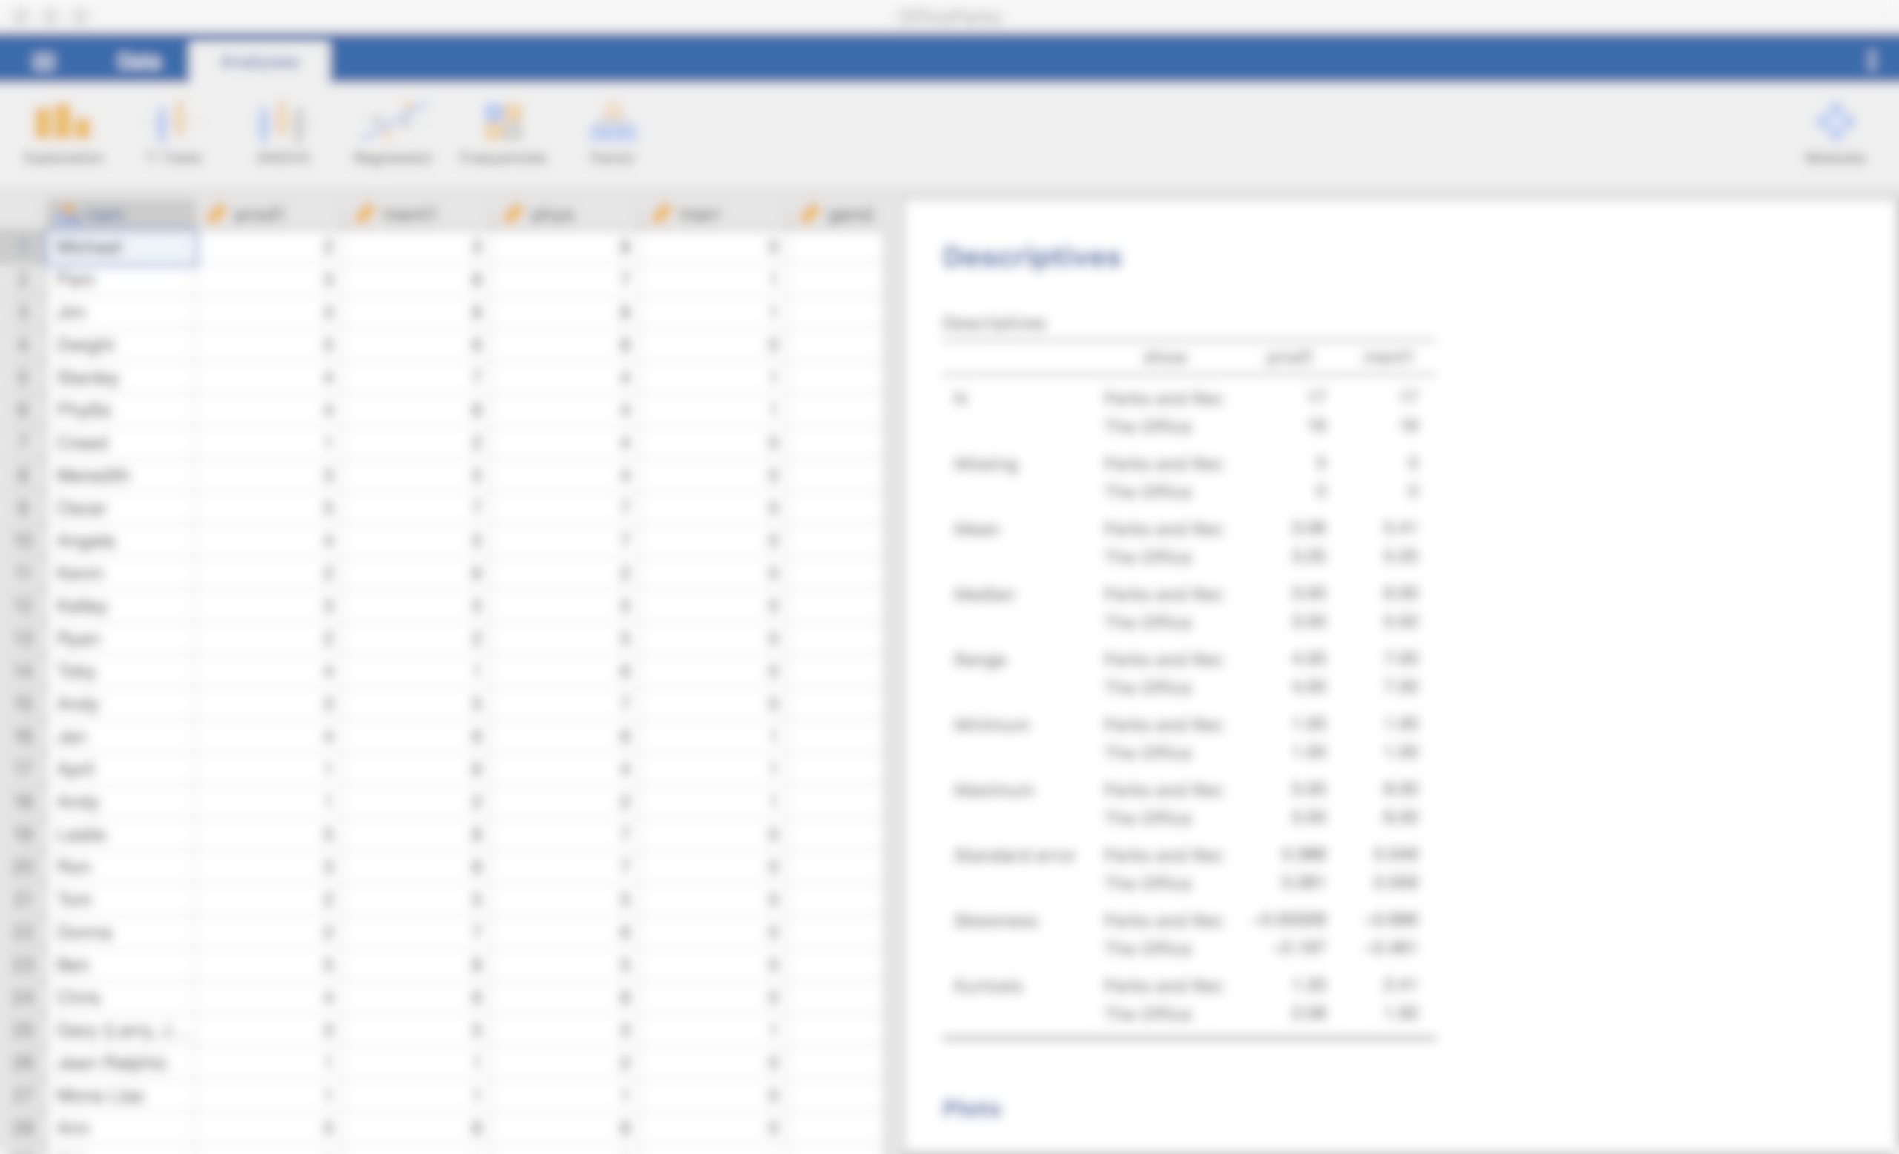
Jamovi
Free
Based on Spreadsheets (like Excel or Google Sheets)
Similar to SPSS (simpler, fewer abilities)
Point-and-click
Data and analyses saved together

Slide 12
Tell us about yourself
https://docs.google.com/spreadsheets/d/1JaggNgUtkdzQ9T-FTNDsvf0D6DRM1psMJZvcKuYSaxI/edit?usp=sharing
first_name: your first name
degree: the degree you’re pursuing
grow_up: what you want to do when you grow up
hobby: one of your hobbies
where_from: where are you from?
would_rather: fly or money?
amount_netflix: how much time per week spent watching Netflix
rating_office: rating 0-10 of The Office (US)

Slide 13
Tell us about yourself
https://docs.google.com/spreadsheets/d/1JaggNgUtkdzQ9T-FTNDsvf0D6DRM1psMJZvcKuYSaxI/edit?usp=sharing
We will practice with Jamovi next week using this data
first_name: your first name
degree: the degree you’re pursuing
grow_up: what you want to do when you grow up
hobby: one of your hobbies
where_from: where are you from?
would_rather: fly or money?
amount_netflix: how much time per week spent watching Netflix
rating_office: rating 0-10 of The Office (US)

Slide 14
Data and spreadsheets
Get used to working with spreadsheets
Excel, Google Sheets, Numbers, etc.

Slide 15
Good data practices
Save a master data file that does not change after you have cleaned up the file
Do NOT save subsetted data files (e.g., removed all ages < 20)
Instead save the analyses
Save the master file on multiple devices (flash drive, cloud, computer)
Broman et al. (2017)

Slide 16
Good data practices
Double check your work
Re-run the same analyses after closing down the file and software
Keep track of all your data and analysis
Broman et al. (2017)

Slide 17
Assignments require your own data
You can use any data that you’d like, if:
It has both continuous and categorical variables
It has at least 20 participants
It is available for you to use in class (de-identified)

Slide 18
Assignments require your own data
Continuous is where the values of the variable can be a wide, continuous range
You can use any data that you’d like, if:
It has both continuous and categorical variables
It has at least 20 participants
It is available for you to use in class (de-identified)

Slide 19
Assignments require your own data
Categorical is where the values of the variable can only be a few, predefined values
You can use any data that you’d like, if:
It has both continuous and categorical variables
It has at least 20 participants
It is available for you to use in class (de-identified)

Slide 20
Questions?

Slide 21
Next week:
Working with Data
Overview of Statistics
Intro to Statistical Terminology
Intro to Jamovi

